Slide 1
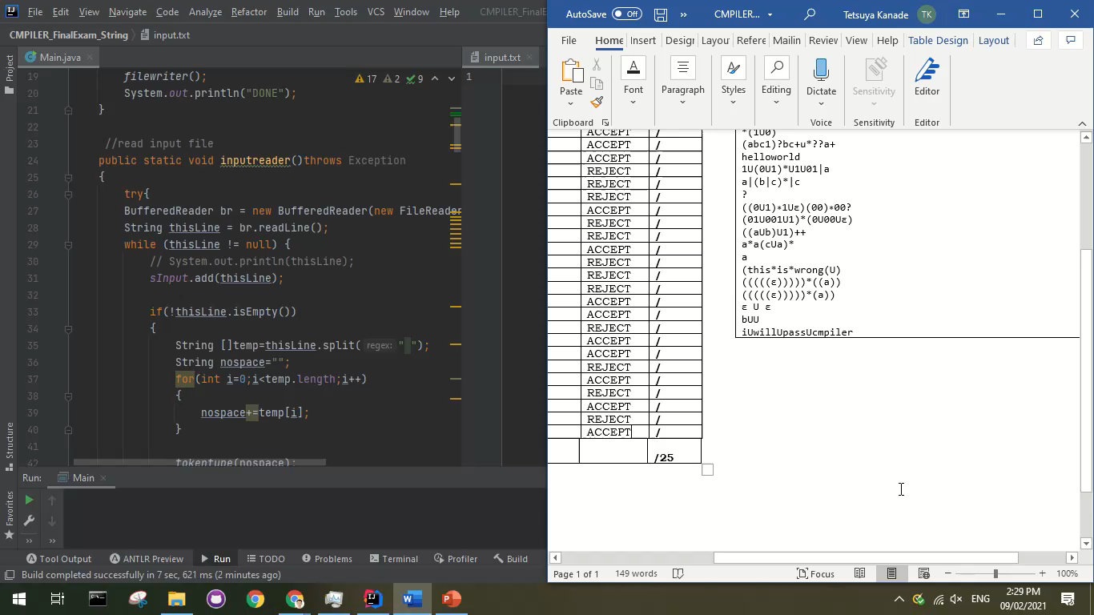
Xu, Aaron John S.
S 12

Slide 2
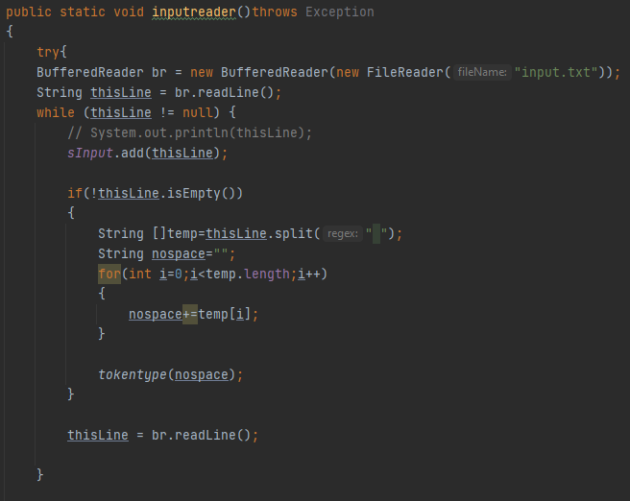
▪ Reading the text input.
Use BufferedReader
For each line split in white space and concatenate to form a single input with no spaces to determine the token type of each input.

Slide 3
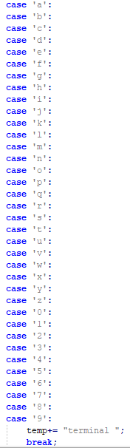
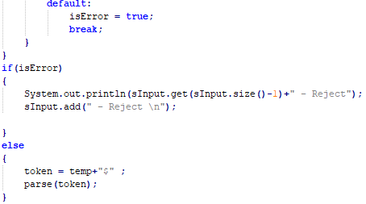
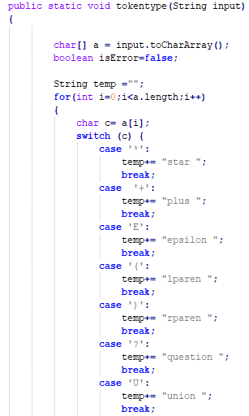
▪ Token
Split the input into single characters then match to corresponding token type. If there is no matching token type then it is an ERROR, which will then just be instantly tagged as ERROR and will not continue to the parsing stage.
Legend:
* = star
+ = plus
E = epsilon
( = lparen
) = rparen
? = question
U = union
[a-z][0-9] = terminal

Slide 4
Grammar Rule
Rule | First Set | Follow Set
A -> B C | First(A) -> { epsilon, lparen, terminal } | Follow(A) -> { $, rparen }
B -> D | epsilon | First(B) -> { epsilon, lparen, terminal } | Follow(B) -> { union, $, lparen, terminal, rparen }
C -> union B C | D C | # | First(C) -> { union, #, lparen, terminal } | Follow(C) -> { $, rparen }
D -> E F | First(D) -> { lparen, terminal } | Follow(D) -> { union, $, lparen, terminal, rparen }
E -> lparen A rparen | terminal | First(D) -> { lparen, terminal } | Follow(E) -> { star, question, plus, union, $, lparen, terminal, rparen }
F -> star | question | plus | # | First(F) -> { star, question, plus, # } | Follow(F) -> { union, $, lparen, terminal, rparen }

Slide 5
Parsing Table
Nonterminal | epsilon | union | lparen | rparen | terminal | star | question | plus | $
A | A -> B C |  | A -> B C |  | A -> B C
B | B -> epsilon |  | B -> D |  | B -> D
C |  | C -> union B C | C -> D C | C -> # | C -> D C |  |  |  | C -> #
D |  |  | D -> E F |  | D -> E F
E |  |  | E -> lparen A rparen |  | E -> terminal
F |  | F -> # | F -> # | F -> # | F -> # | F -> star | F -> question | F -> plus | F -> #

Slide 6
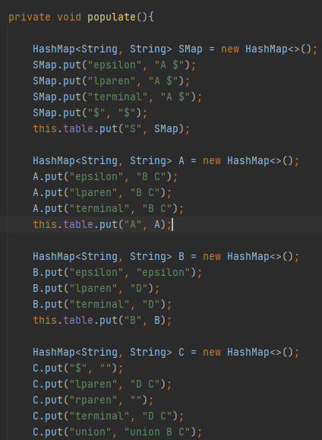
LL1 Table
Populating the table is just putting the pairs from the Parsing Table into the code, if it is NULL in the parsing table then it is not needed to be stated inside the code.

Slide 7
LL1 Table
Populating the table is just putting the pairs from the Parsing Table into the code, if it is NULL in the parsing table then it is not needed to be stated inside the code.

Slide 8
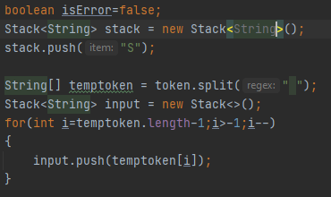
LL1 Parser
“stack” is used for the rules.
Initialize with “S” (the starting rule)
“input” is used for the tokens.
To populate, split the tokens on whitespaces
Reverse it then push to the token

Slide 9
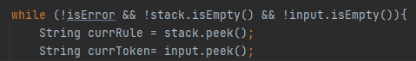
LL1 Parser
Repeat the loop while there are no errors and while there are still rules or input inside a stack
currRule takes the current production rule
currToken takes the current input token

Slide 10
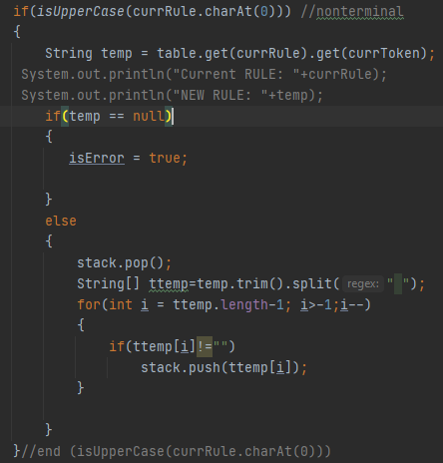
LL1 Parser
For nonterminal
If there are no available rule for the current rule and current input then the input is rejected
Else we remove the matched nonterminal and then push to the stack the other found rules

Slide 11
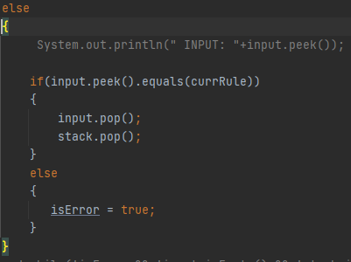
LL1 Parser
For terminals
If the current terminal tokenized is the same with the current terminal in the rule the we just pop it from both stacks.
If they are not the same then it means that the input is not accepted.

Slide 12
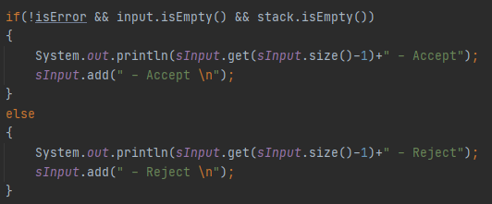
LL1 Parser
If there are no errors and both stacks are empty then it means that the input is an accepted regular expression
If there is an error or there are still element/s inside either of the stacks then it means that it is not accepted.

Slide 13
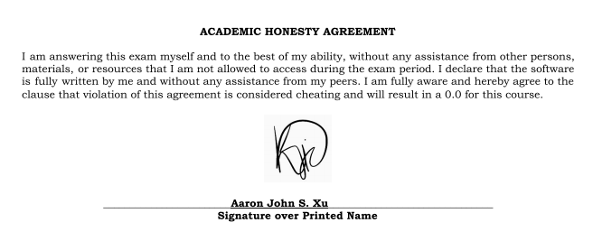
Academic Honesty Agreement

